Slide 1
FINANCIAL FRAUD DETECTION AND IMPLEMENTATION OF LVQ ALGORITHM
MACHINE LEARNING 1 PROJECT
UDBHAV KUSH
Notes:
Credit card fraud happens when someone (mostly a fraudster) uses the stolen credit card or the credit card information to make unauthorized purchases.

Slide 2
TABLE OF CONTENT
About The Dataset
Exploratory Data Analysis
Class Imbalance
Modelling
Logistic Regression
Decision Tree
KNN
LVQ
Comparison of Results
Limitation and Future Scope

Slide 3
About the Dataset:
Using 100k samples in the dataset.
CATEGORICAL
IsFraud – 0, 1
Type
TRANSFER
CASH_OUT
CASH_IN
PAYMENT
DEBIT
NUMERICAL
Amount
Oldbalanceorig
Newbalanceorig
oldbalanceDest
newbalanceDest

Slide 4
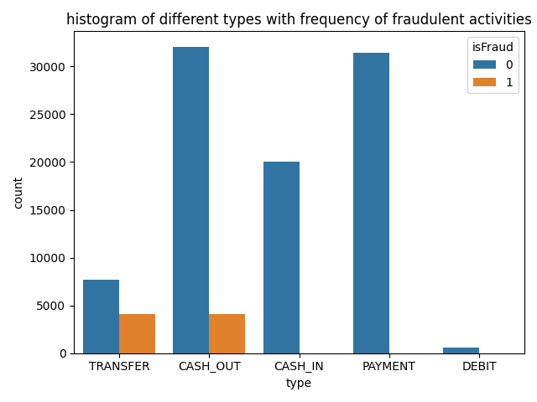
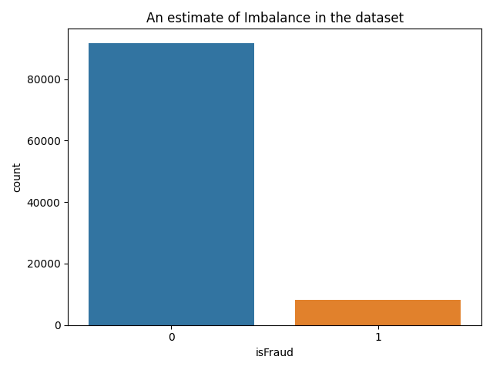
BASIC EDA:
Notes:
Transfer is basically the transferring money out of the payment system. So all the fraudulent activities are occurring when the payments are going out of the payment system.

Slide 5
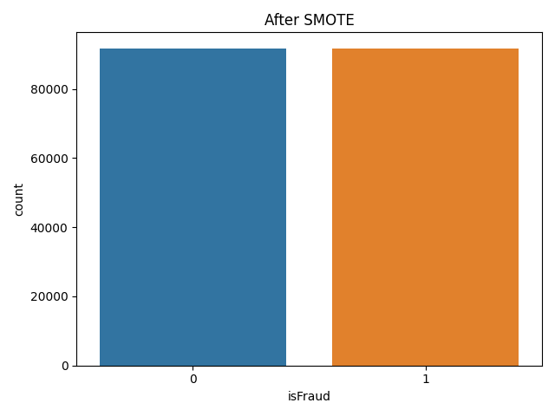
CLASS IMBALANCE
SMOTE
Notes:
Around 97k values in non fraudulent activities and 8k in fraudulent activities

Slide 6
Modelling:
Logistic Regression
Decision Tree
K-Nearest Neighbors
Learning Vector Quantization (LVQ)

Slide 7
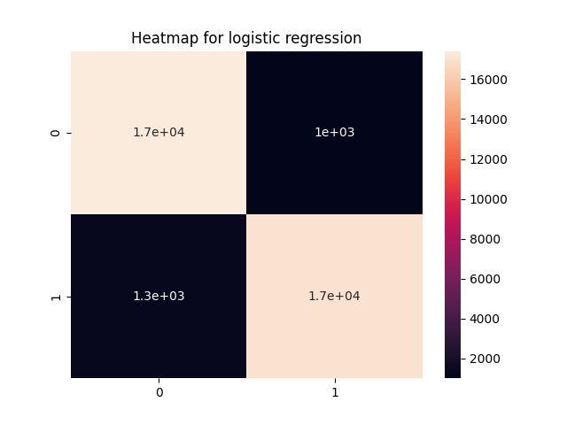
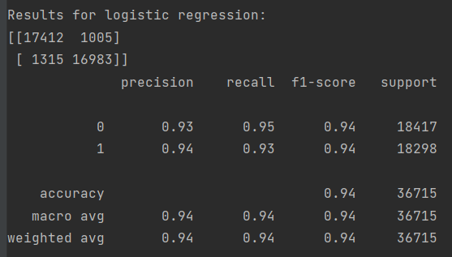
Logistic Regression

Slide 8
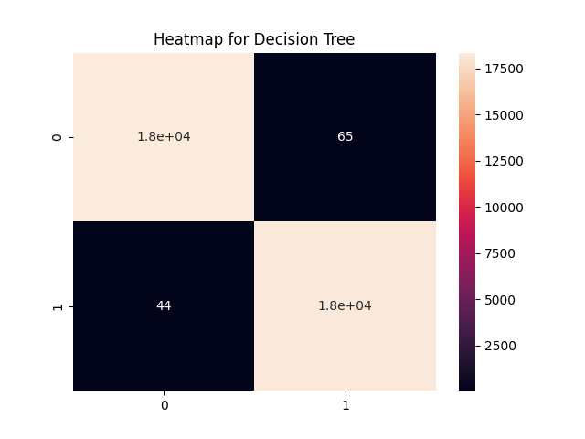
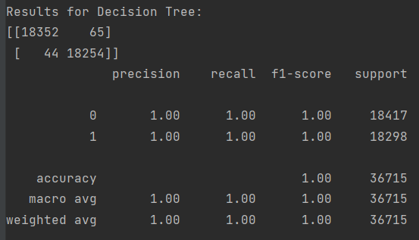
Decision Tree

Slide 9
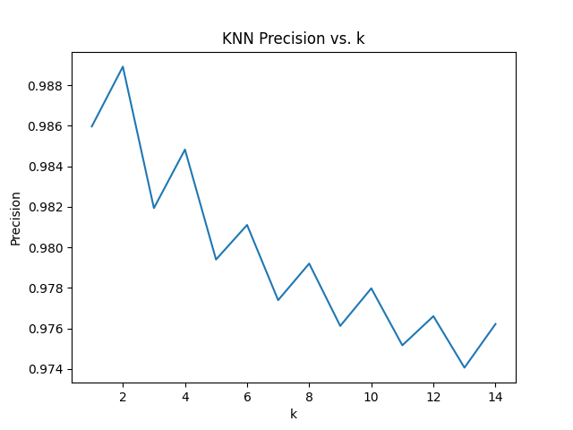
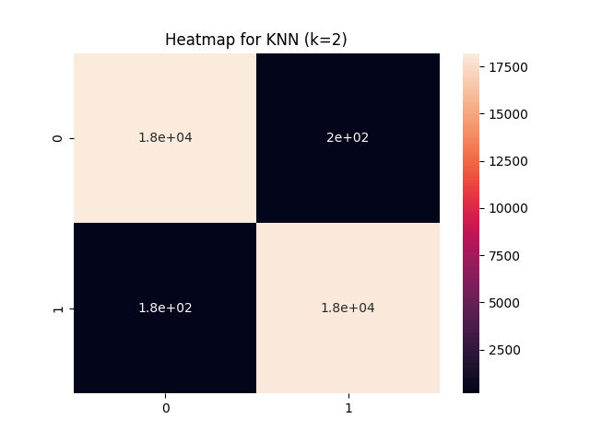
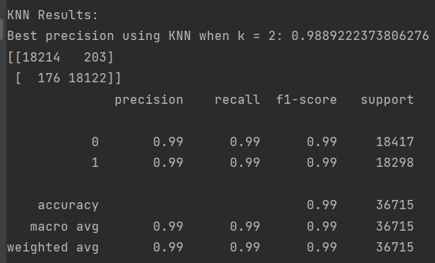
KNN

Slide 10
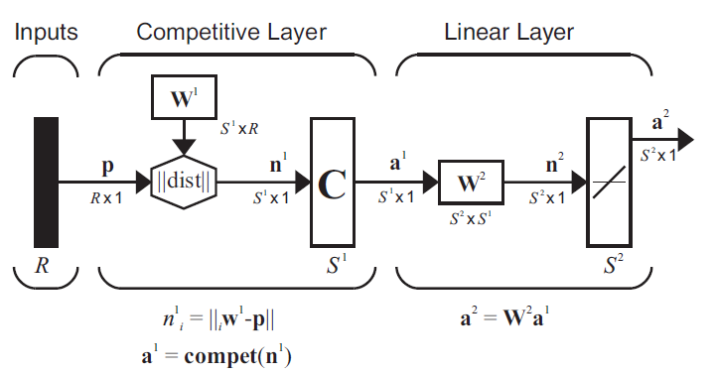
Learning vector quantization
Two layered Network.
First layer is distance calculation and using Competitive Network.
Second layer is normal linear layer.

Slide 11
implementation
Randomly initialized weights of layer 1 and assigned weights of layer 2.
Input vector from each row of the dataframe.
Calculated the distance of the input from each neuron weights and fed to the competitive layer.
Calculated output of layer using linear layer.
If output is equal to target, then updated weights of the winning neuron and made them closer to input.
Else, updated weights of winning neuron and made them away from the input and updated weights of the closest neuron with the correct classification closer to the input.

Slide 12
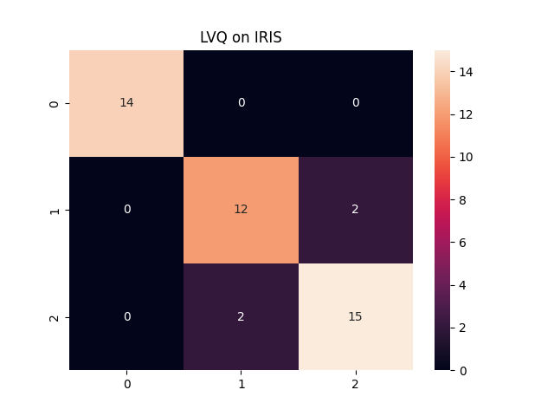
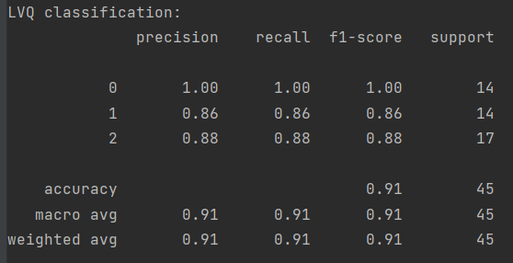
RESULTS OF LVQ ON IRIS DATASET

Slide 13
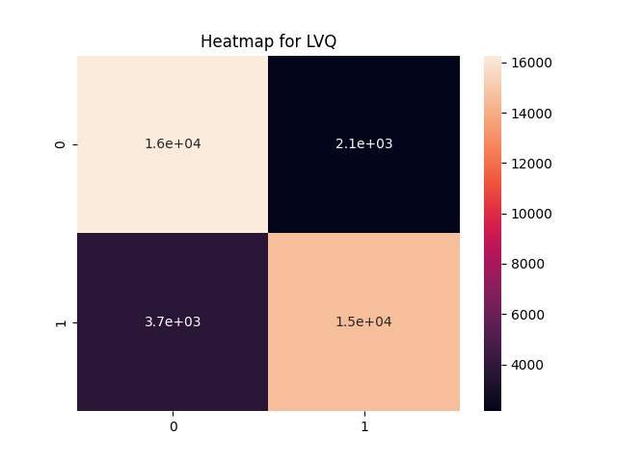
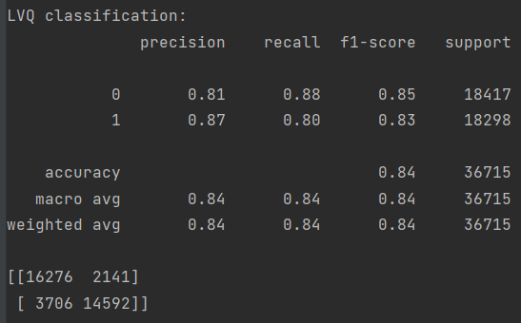
RESULTS USING LVQ ON the financial dataset
Notes:
Results were not as impressive as I expected. Average F1 score using LVQ is around 84% which is not bad but decision boundary and KNN are outperforming by a huge margin.

Slide 14
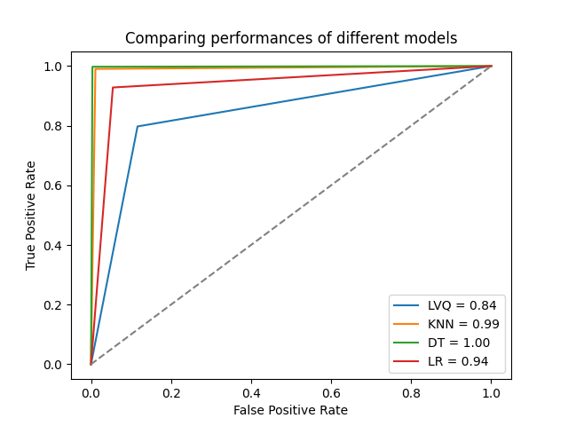
COMPARISON OF ALL THE MODELS
Decision Tree outperforms every other model with AUC value of almost 1.

Slide 15
LIMITATION AND FUTURE SCOPE
Generalize the LVQ algorithm for different subclasses in layer 1.

Slide 16
THANKS!

